Slide 1
CLSI EP15-A3 (Ed4)
Hassan Bayat
Clinical Laboratory Scientist
Sina Clinical Laboratory (Iran)

Slide 2
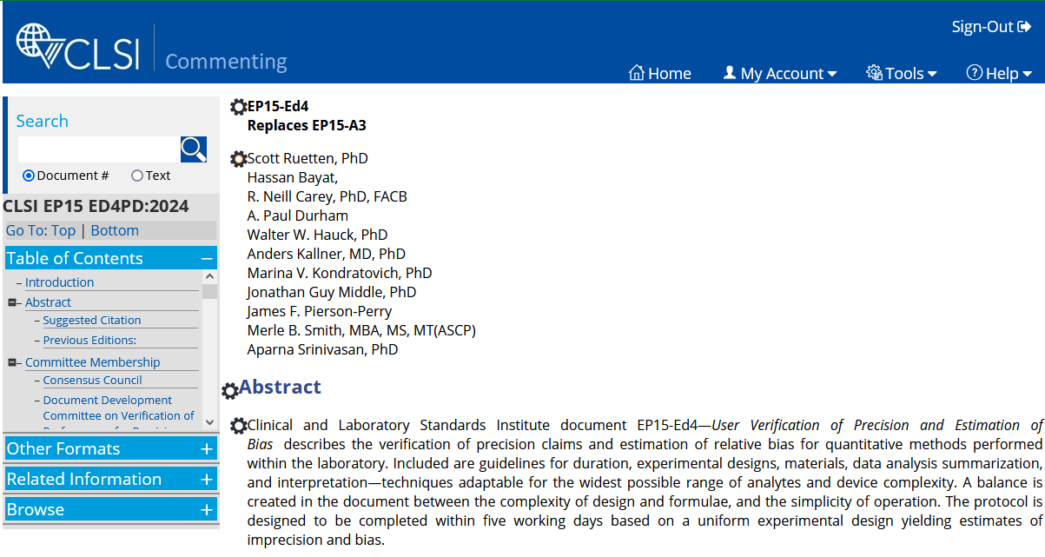

Slide 4
Validation vs Verification
Validation: Evaluating method
Long-term studies
Meeting intended purposes
Precision validation: CLSI EP05
Bias validation: CLSI EP09
Verification: Evaluating user lab’s performance
Short-term studies
Consistency with manufacturers claims
Precision validation: CLSI EP15

Slide 6
Application of EP15
Main application: Implementing an established method
Other: Confirming performance following corrective actions

Slide 7
Overview
5 days (not necessarily consecutive)
If test materials with known target values, estimate bias in addition to verifying imprecision
Training operators
Material selection
Implementing QC
Verifying IMPRECISION
Estimating BIAS
END

Slide 8
Run definition in EP15
The time in which stable performance is expected
Not more than 24 hours
Not more than the duration specified by manufacture
Consider manufacture’s validation study

Slide 9
Specify APS (analytical performance specification)
Set APS Before choosing a method
If manufacture’s claim doesn’t meet APS:
Choose another method
Or
More lenient APS

Slide 10
Documentation
The study as a whole as well the details of runs and replicates
Instrument, measurand (analyte, quantity, unit)
Reagent/calibrator lot number
Rationale for selecting the levels
Test material structure and, if available, its assigned value
Software
Operators, data evaluation and interpretation
Study design; decision for extending study

Slide 11
Part 1

Slide 12

Reproducibility
Within-Lab
Day-to-day
Run-to-run
Repeatability

Slide 13

Reproducibility
Within-Lab
Day-to-day
Run-to-run
Repeatability
One lab
Short time
One operator
Same instrument
Same devices
Within-run
precision

Slide 14
Reproducibility
Within-Lab
Day-to-day
Run-to-run
Repeatability
One lab
Same instrument
Specified time
Different operators
Different devices
May different reagent/calibrator lots
One lab
Short time
One operator
Same instrument
Same devices
Within-run
precision
Total precision

Slide 15
Reproducibility
Within-Lab
Day-to-day
Run-to-run
Repeatability
Different labs
Long time
Different reagent lots
Different calibrator lots
Different operators
Different instruments/devices
One lab
Same instrument
Specified time
Different operators
Different devices
May different reagent/calibrator lots
One lab
Short time
One operator
Same instrument
Same devices
Within-run
precision
Total precısıon

Slide 16
Reproducibility
Within-Lab
Day-to-day
Run-to-run
Repeatability
Different labs
Long time
Different reagent lots
Different calibrator lots
Different operators
Different instruments/devices
One lab
Same instrument
Specified time
Different operators
Different devices
May different reagent/calibrator lots
One lab
Short time
One operator
Same instrument
Same devices

Slide 17
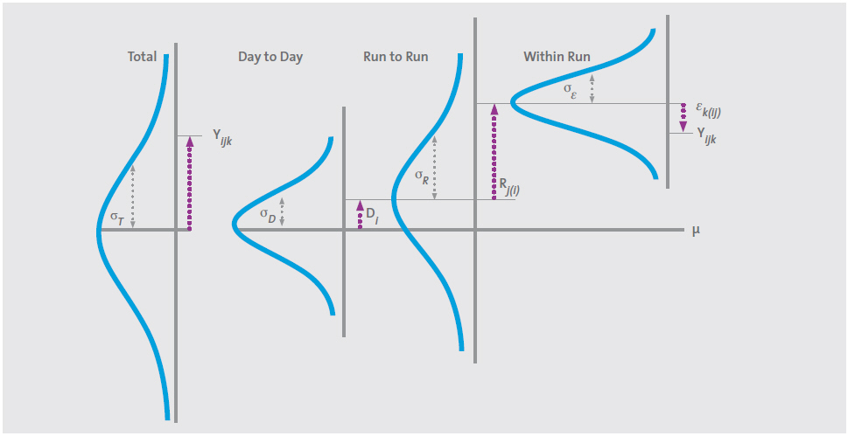

Slide 18
Overview, Limitations
At least 5 days, 1 run per day, 5 replicates per run
False rejection = 5%
Detecting large deviations from manufacture’s claim
Claims are treated as if they have no uncertainty

Slide 19

Advantages
Time
Compromise between lab resources and study’s quality
Evaluating repeatability & within-lab precision at the same time
Robustness of calculations and estimates
Material
Informative evaluation
Sufficient evaluation

Slide 20
Symbols
Population
Sample
Precısıon type | Manufacture claim | Lab estimate
Repeatability | σ_{R} | S_{R}
Within-lab | σ_{WL} | S_{WL}

Slide 21
Samples
Type:
Preferably patient specimen (single or pooled)
Commercial specimens
Be compatible with manufacture study

Slide 22
Level
Clinical decision levels
Normal & abnormal intervals
Levels close to manufacture study makes easier to verify claims
Not out of manufacture claimed levels

Slide 23
Assaying samples
Calibrate at the start at the study
If manufacture has done several calibrations, consider extra calibrations
All the users be involved; even for fully automated analyzers

Slide 24
Data integrity
Identifying results or runs that are different
Evaluate results each day → Aberrant results not reflecting performance

Slide 25
Data integrity
Identifying results or runs that are different
Evaluate results each day → Aberrant results not reflecting performance

Slide 26
Data integrity
Evaluate results each day → Aberrant results not reflecting performance
Don’t rely on guess and assumption
Don’t delete or repeat results just for being different
Correcting typing mistakes, misplaced samples, …
Irrelevant errors: clog, insufficient volume, …
If QC failed, delete whole run
Document any correction, deletion, missing, and repeats

Slide 27
DON’T delete any result as statistical “outlier” at this phase
After correcting/repeating attributable results; if still aberrant results:
Do the calculations with all results; If claim is verified, outlier test isn’t needed
If not:
Do statistical outlier test and repeat calculations after deleting probable statistical outlier

Slide 28

Treating Probable outliers (after deleting attributable results )
Maybe because of an unknown irrelevant reason to performance
Maybe because of performance; inconsistent with the small number of data but consistent with a larger study
Delete or keep?

Slide 29
Example: Inconsistent with a small number of data but consistent with a larger study

Slide 30
Example: Inconsistent with a small number of data but consistent with a larger study

Slide 31
Example: Inconsistent with a small number of data but consistent with a larger study

Slide 32
Example: Inconsistent with a small number of data but consistent with a larger study
Better estimate
Keeping: SD = 2.06
Deleting: SD = 0.49

Slide 33

Delete while truly related to performance
Keeping while irrelevant to performance
Risk of optimistic estimation
Risk of false rejection
Confirm an apparently outlier with an appropriate statistical test; e.g. Grubbs’ test.
Delete at most 1 result per level, and 2 results per whole study.
Note: Even if a results is confirmed as a statistical outlier but doesn’t lead to fail verification, don’t delete it.

Slide 34
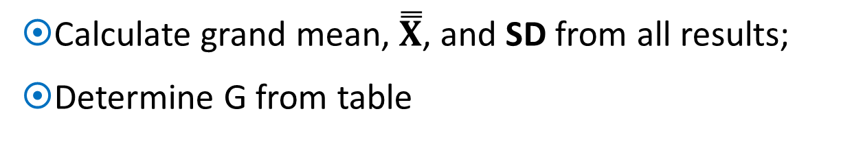
Grubbs’ test
Calculate grand mean, $\overset{̿}{X}$, and SD from all results;
Determine G from table
G factor for 5 runs
G | N
3.087 | 23
3.112 | 24
3.135 | 25
A result is outlier if, and only if, it more the G•SD away from mean

Slide 35
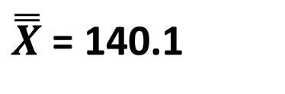

EXAMPLE
G factor for 5 runs
G | N
3.087 | 23
3.112 | 24
3.135 | 25
✓
✓
$\overset{̿}{X}$= 140.1
Grubs’ limits = $\overset{̿}{X}$± G*SD
SD = 2.30
= 140.1 ± (3.135 x 2.30) = 132.9 & 147.3

Slide 36
Effective number of runs, n₀
Number of runs adjusted for missing data
Effective number of runs (5 runs)
n₀ | N
4.565 | 23
4.792 | 24
5 | 25

Slide 37
Estimating lab precision; ANOVA
Separating total variation to “within-group” and “between-group” components
within-run & between-run precision

Slide 38
Estimating lab precision; ANOVA
Sum Square (of Deviations from Mean)
Degrees of Freedom
Mean Square
(SS/DF)
nRun - 1
N - nRun
N - 1
Separating total variation to “within-group” and “between-group” components
within-run & between-run precision

Slide 39
Estimating lab precision; ANOVA
Sum Square (of Deviations from Mean)
Degrees of Freedom
Mean Square
(SS/DF)
Repeatability Variance
V_{R} = MS2
“Pure” between-run variance
V_{B} = (MS1 – MS2)/n₀
V_{WL} = V_{W} + V_{B}
Within-lab variance
Separating total variation to “within-group” and “between-group” components
within-run & between-run
nRun - 1
N - nRun
N - 1

Slide 40
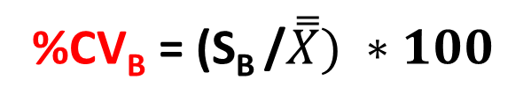
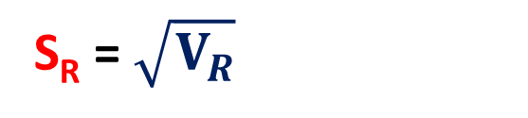
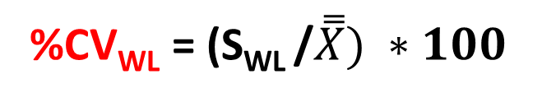
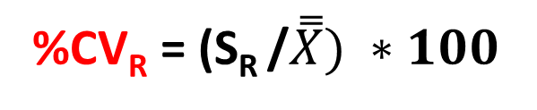

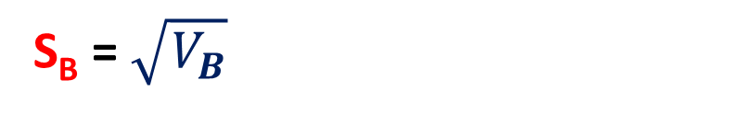
Repeatability Variance
Having components help specify sources of variation
V_{R} = MS2
S_{R} = $\sqrt{V_{R}}$
%CV_{R} = (S_{R} /$\overset{̿}{X}) ∗100$
“Pure” between-run variance
%CV_{B} = (S_{B} /$\overset{̿}{X}) ∗100$
V_{B} = (MS1 – MS2)/n₀
S_{B} = $\sqrt{V_{B}}$
V_{WL} = V_{W} + V_{B}
S_{WL} = $\sqrt{V_{WL}}$
%CV_{WL} = (S_{WL} /$\overset{̿}{X}) ∗100$
Within-lab variance

Slide 41
ANOVA
Source of Variation | SS | DF | MS
Between Run | 63.44 | 4 | 15.86
Within Run | 63.20 | 20 | 3.16
Total | 126.64 | 24
SUMMARY
Groups | Count | Sum | Average | Variance
Run 1 | 5 | 695 | 139 | 1
Run 2 | 5 | 704 | 140.8 | 6.2
Run 3 | 5 | 691 | 138.2 | 5.2
Run 4 | 5 | 714 | 142.8 | 1.7
Run 5 | 5 | 699 | 139.8 | 1.7
V_{R} = 3.16
S_{R} = 1.78
CV_{R} = 1.27%
(S/140.1) * 100
V_{B} = (15.86 – 3.16)/5 = 2.54
S_{B} = 1.59
CV_{B} = 1.13%
V_{WL} = 3.16 + 2.54 = 5.70
S_{WL} = 2.39
CV_{WL} = 1.71%

Slide 42
Determine manufacture claim
If lab mean differs from manufacture’s mean (that usually is):
Claimed CV at closest PI mean to lab mean
Interpolation or averaging 2 or 3 claimed CVs around lab mean
Using precision profile (if present)

Slide 43

Compare estimates to claims
If lab performance is the same as manufacture and repeats verification study many times:
Approximately half of estimates would be less than claim
Approximately half of estimates would be higher than claim

Slide 44

Compare estimates to claims
If lab performance is the same as manufacture and repeats verification study many times:
Approximately half of estimates would be less than claim
Approximately half of estimates would be higher than claim
Upper Verification Limit; UVL
σ
Pass
Fail
(for each estimate)False rejection = 50%
(for whole study)FR = 1 – (50%)^{2*nSam}
nSam = 1 → FR = 75%
nSam = 2 → FR = 94%
nSam = 1 → FR = 98%

Slide 45
UVL = F * σ
Upper Verification Limit; UVL
σ
(for whole study) False rejection = 5%

Slide 46
Calculate F (thereby UVL)
→ UVL = 1.3 * σ
Rule of thumb: F = 1.3
To calculate F exactly:
Determine df_{R} and df_{WL}
df_{R} = N – nRun
df_{WL}
ρ = σ_{WL} / σ_{R}

Slide 47
Calculate F (thereby UVL)
→ UVL = 1.3 * σ
Rule of thumb: F = 1.3
To calculate F exactly:
Determine df_{R} and df_{WL}
df_{R} = N – nRun
df_{WL}
ρ = σ_{WL} / σ_{R}
Find F from table for given df and nSamp

Slide 48
Summary of Calculations
At least 5 day
5 replicate/day
ANOVA
S_{R}
S_{WL}
Package insert
σ_{R}
σ_{WL}
F * σ
UVL_{R}
UVL_{WL}
df_{R}
df_{WL}
nSam
F_{R}
F_{WL}

Slide 49
Summary of Calculations
Comparing estimates to claims:
Compare to claim; if not passed,
Compare to UVL
At least 5 day
5 replicate/day
ANOVA
S_{R}
S_{WL}
σ_{R}
σ_{WL}
Package insert
σ_{R}
σ_{WL}
F * σ
UVL_{R}
UVL_{WL}
df_{R}
df_{WL}
nSam
F_{R}
F_{WL}
NOTE: Because of small sample volume, both false verification and false rejection is probable

Slide 50
Probable scenarios
Interpretation
1A) All estimates are smaller than claim or well smaller than UVL
The overall study is consistent with the claims
Imprecision in the user’s laboratory is comparable to the claims
1B) All passed, but some pass just barely
The overall study is consistent with claims
Monitor daily QC carefully to ensure imprecision remains consistent with claim

Slide 51
2) Most estimates accepted but some fail
The lab director should decide considering clinical aspect
(if decided to use method) Imprecision exhibited by daily QC be carefully monitored
3) Several estimates fail
The study as a whole is not consistent with the claims
Reject the method
Troubleshoot and repeat study
Perform CLSI EP05

Slide 52
EXAMPLE: Verifying a Ferritin assay
Manual assay → Fully automate assay; AMR = 10-1000 μg/L
Precision is concentration-depended
Lower, higher & normal results are clinically important
Manufacture study included several calibrations
Levels: Low, Normal, and High
Sample: Pooled sera
Calibration: Before each run

Slide 54

Grubbs’ Test
G factor for 5 runs
G | N
3.087 | 23
3.112 | 24
3.135 | 25
Grubbs’ limits = $\overset{̿}{X} ±$ (G • SD)

Slide 55

G factor for 5 runs
G | N
3.087 | 23
3.112 | 24
3.135 | 25
Grubbs’ Test
Grubbs’ limits = $\overset{̿}{X} ±$ (G • SD)

Slide 56
ANOVA
V_{W} (V_{R}) = MS2
Effective number of runs (5 runs)
n₀ | N
4.565 | 23
4.792 | 24
5 | 25
V_{B} = (MS1 – MS2)/n₀
V_{WL} = V_{W} + V_{B}
V_{W} = 1.3284
V_{B} = (4.238 – 1.3284)/5
V_{B} = 0.58192
V_{WL} = 1.3284 + 0.58192
V_{WL} = 0.58192

Slide 57
ANOVA
V_{W} (V_{R}) = MS2
Effective number of runs (5 runs)
n₀ | N
4.565 | 23
4.792 | 24
5 | 25
V_{B} = (MS1 – MS2)/n₀
V_{WL} = V_{W} + V_{B}
V_{W} = 1.3284
V_{B} = (4.238 – 1.3284)/5
V_{B} = 0.58192
V_{WL} = 1.3284 + 0.58192
V_{WL} = 0.58192

Slide 58
Claims & UVLs

Slide 59
Claims & UVLs
df_{R} = N – nRun
df_{R} = 25 – 5 = 20

Slide 60
Claims & UVLs
df_{R} = N – nRun
df_{R} = 25 – 5 = 20

Slide 61
Claims & UVLs
df_{R} = N – nRun
df_{R} = 25 – 5 = 20

Slide 62
Claims & UVLs
ρ = σ_{WL} / σ_{R}

Slide 63
Claims & UVLs
ρ = σ_{WL} / σ_{R}

Slide 64
Claims & UVLs
ρ = σ_{WL} / σ_{R}

Slide 65
Claims & UVLs
ρ = σ_{WL} / σ_{R}

Slide 66
Claims & UVLs

Slide 67
Comparing Estimates vs Claims
a) Repeatability precision
1 outlier result deleted; N=24

Slide 68
1 outlier result deleted; N=24
Comparing Estimates vs Claims
a) Repeatability precision

Slide 69
Comparing Estimates vs Claims
a) Repeatability precision

Slide 70

Comparing Estimates vs Claims
a) Repeatability precision

Slide 71
Comparing Estimates vs Claims
a) Repeatability precision

Slide 72
Comparing Estimates vs Claims
a) Repeatability precision

Slide 73
Comparing Estimates vs Claims
a) Repeatability precision

Slide 74
Comparing Estimates vs Claims
a) Repeatability precision

Slide 75
Comparing Estimates vs Claims
b) Within-lab precision

Slide 76
Comparing Estimates vs Claims
b) Within-lab precision

Slide 77
Comparing Estimates vs Claims
b) Within-lab precision

Slide 78
Comparing Estimates vs Claims
b) Within-lab precision

Slide 79
Comparing Estimates vs Claims
b) Within-lab precision

Slide 80
Interpretation
Considering deleting one result as statistical outlier:
Repeatability & within-lab precision at all 3 levels were confirmed
This study is accepted as a whole: The estimates are generally consistent with the manufacture’s claims
There is no problem with middle and high levels; but it’s recommended performance at low level be monitored carefully

Slide 81
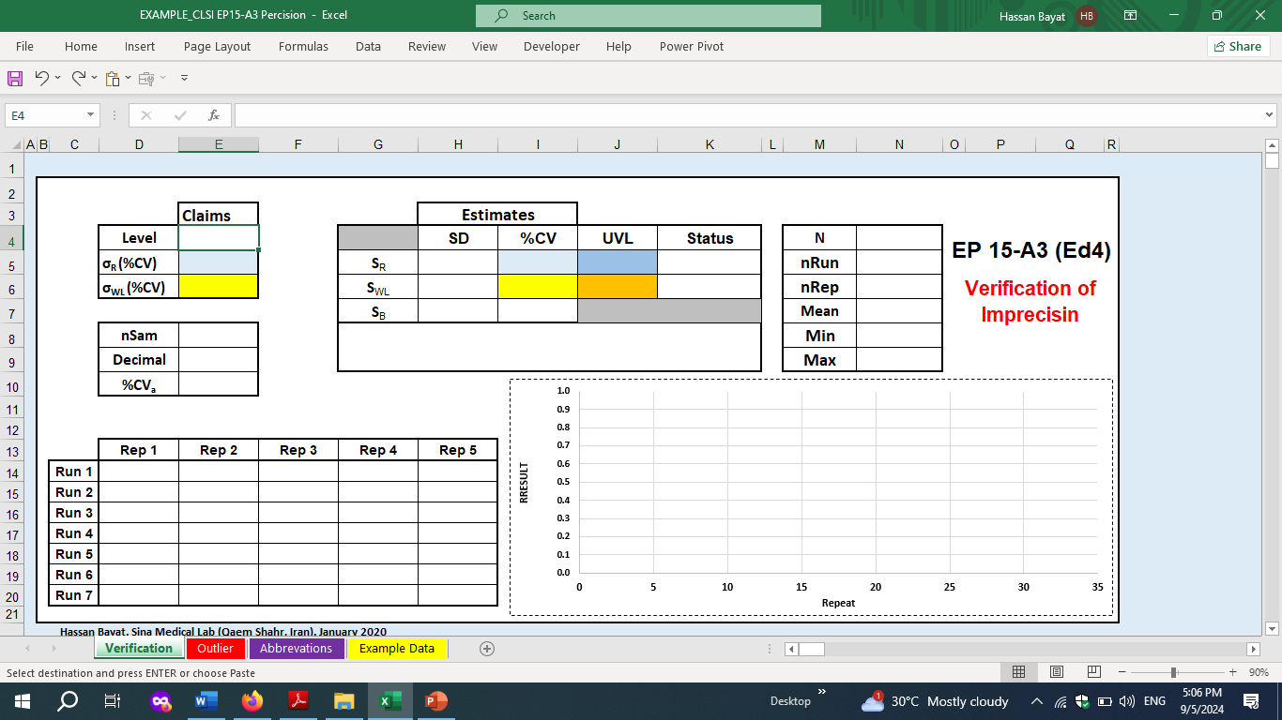

Slide 82
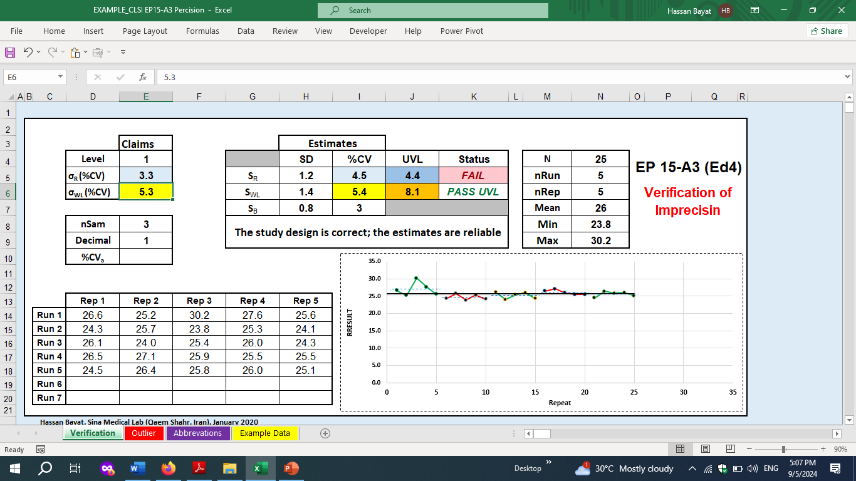

Slide 83
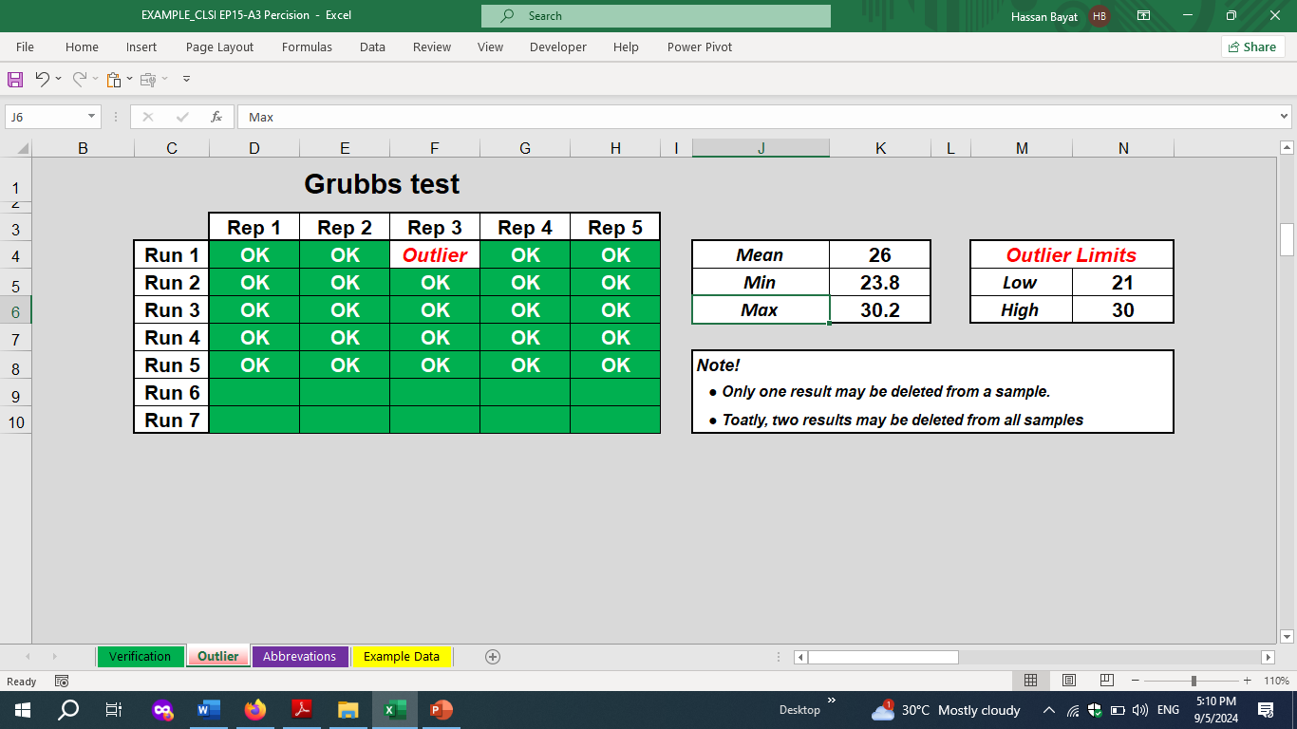

Slide 85
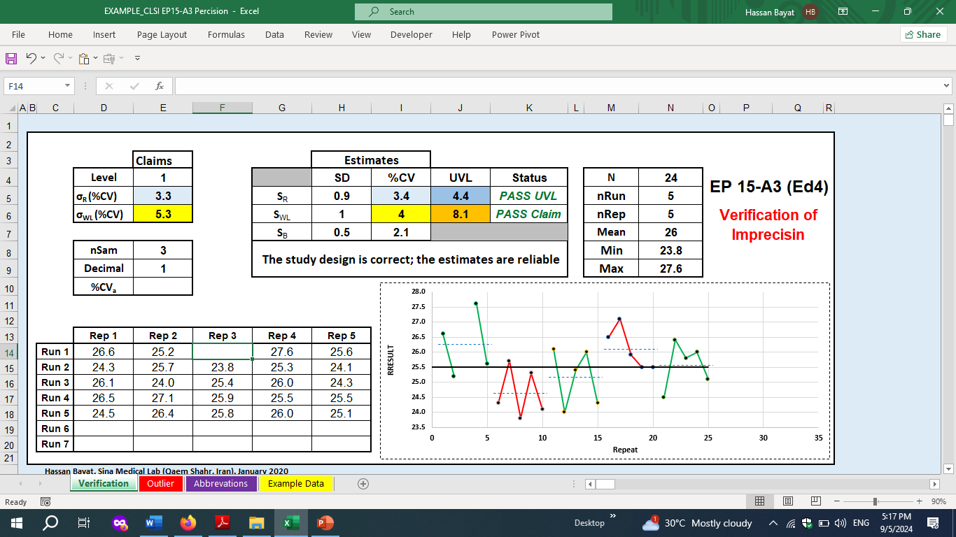

Slide 86
Part 2

Slide 87
Statistical basis
H₀: Bias is zero; lab’s Mean is equal to TV
H_{A}: Bias isn’t zero; lab’s mean differs from TV

Slide 88
Statistical basis
Reference Material (MR) with Target Values
Assaying RM to estimate user Mean
H₀: Bias is zero; lab’s Mean is equal to TV
H_{A}: Bias isn’t zero; lab’s mean differs from TV
TV
Mean
BIAS = Mean - TV

Slide 89
Statistical basis
Reference Material (MR) with Target Values
Assaying RM to estimate user Mean
TV
Mean
Standard uncertainty of RM, u_{RM}
Standard uncertainty of Mean, u_{Mean}

Slide 90
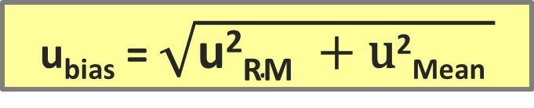
Statistical basis
u_{bias} = $\sqrt{\text{u}\text{2}\text{RM} +\text{u}\text{2}\text{Mean} }$
Standard uncertainty of Bias

Slide 91
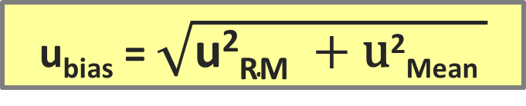
Statistical basis
u_{bias} = $\sqrt{\text{u}\text{2}\text{RM} +\text{u}\text{2}\text{Mean} }$
Standard uncertainty of Bias
U_{bias} = m * u_{bias}
Expanded uncertainty of Bias
TV

Slide 92
Statistical basis
u_{bias} = $\sqrt{\text{u}\text{2}\text{RM} +\text{u}\text{2}\text{Mean} }$
Standard uncertainty of Bias
U_{bias} = m * u_{bias}
Expanded uncertainty of Bias
TV - U_{bias}
TV + U_{bias}
TV

Slide 93

Statistical basis
u_{bias} = $\sqrt{\text{u}\text{2}\text{RM} +\text{u}\text{2}\text{Mean} }$
Standard uncertainty of Bias
U_{bias} = m * u_{bias}
Expanded uncertainty of Bias
TV - U_{bias}
TV + U_{bias}
Verification Interval
H₀: Bias is zero; lab’s Mean is equal to TV
H_{A}: Bias isn’t zero; lab’s mean differs from TV
Lab Mean within VI → Bias Statistically Not Significant
Lab Mean out of VI → Bias Statistically Significant

Slide 94
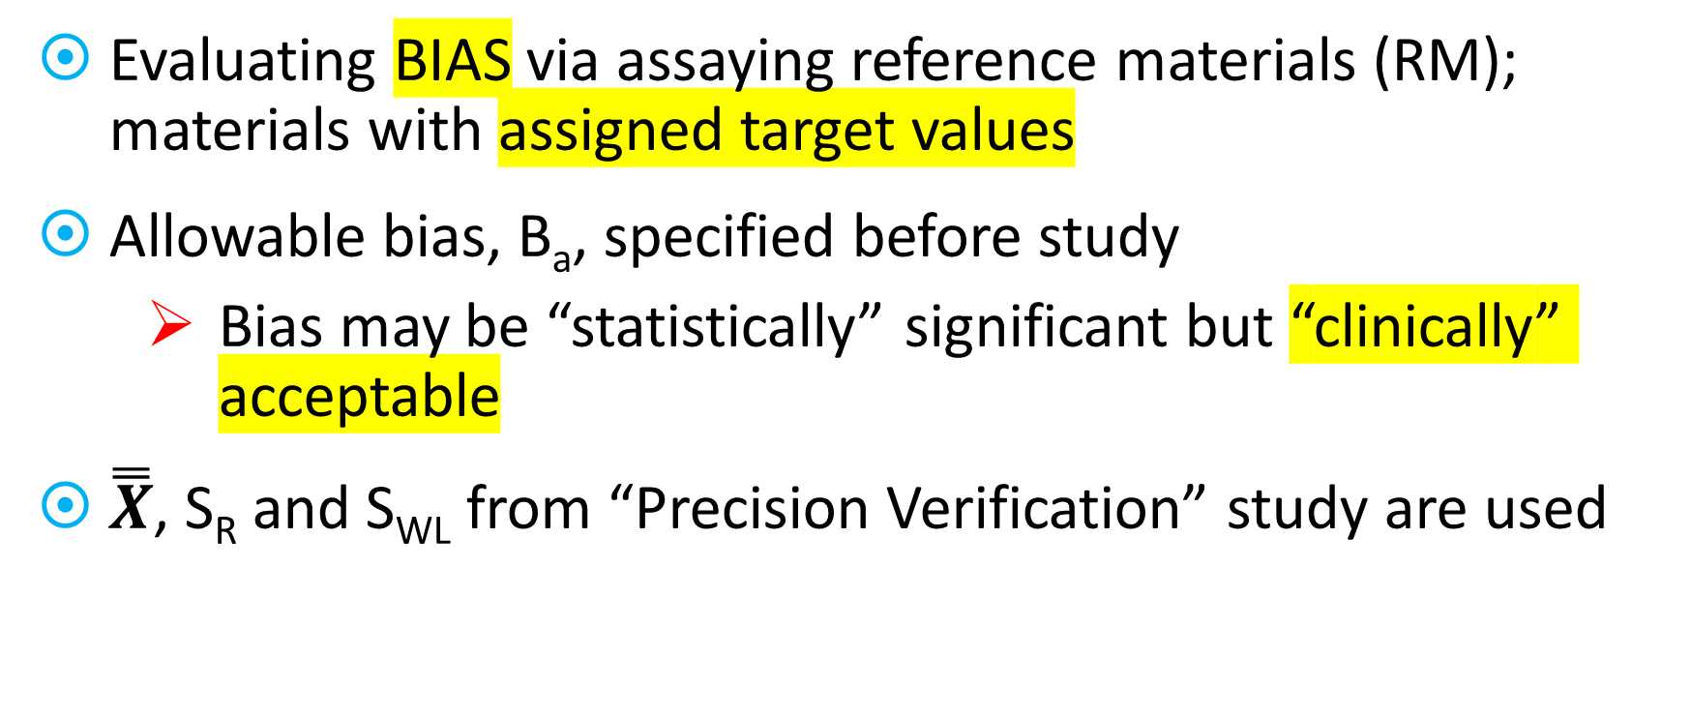
Overview
Evaluating BIAS via assaying reference materials (RM); materials with assigned target values
Allowable bias, B_{a}, specified before study
Bias may be “statistically” significant but “clinically” acceptable
$\overset{̿}{X}$, S_{R} and S_{WL} from “Precision Verification” study are used

Slide 95
Study’s purpose
Depending on the reference material (RM):
Confirm consistency with target value of a CRM
Confirm consistency with TV of EQA/PT
Recovery of an expected value (Spiked material)

Slide 96
Specifications of RMs
Uncertainty of the target value, u_{RM}, must be known
Depending on material, N & DF may be necessary
Standard Reference (CRM) - JCTLM, IFCC, NIST, WHO,…
u_{RM} presented in certificate
df_{RM} = ∞
May not appropriate for some lab: Accessibility, commutability, cost, stability
Spiked sample - e.g. drugs
Practically u_{RM} is considered zero and df_{RM} considered ∞

Slide 97
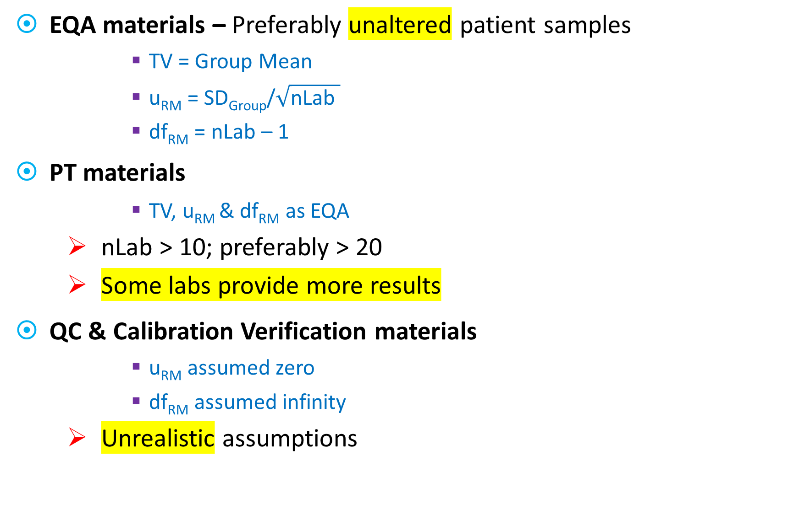
EQA materials – Preferably unaltered patient samples
TV = Group Mean
u_{RM} = SD_{Group}/$\sqrt{\text{nLab} }$
df_{RM} = nLab – 1
PT materials
TV, u_{RM} & df_{RM} as EQA
nLab > 10; preferably > 20
Some labs provide more results
QC & Calibration Verification materials
u_{RM} assumed zero
df_{RM} assumed infinity
Unrealistic assumptions

Slide 98
Conventional TVs
u_{RM} = 0
df_{RM} = ∞
Patient samples tested in one or more central labs
Patient samples sent to a lab traceable to a reference hierarchy
Previously collected QC data
The observed difference reflects “TRUENESS” if a high quality method is used for assigning TV

Slide 99
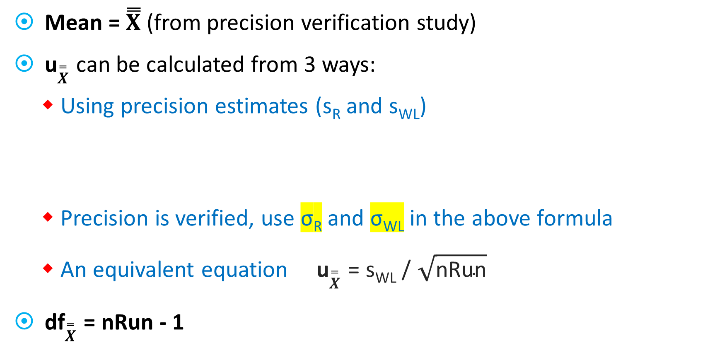
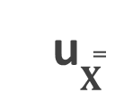
User Mean, its DF & uncertainty
Mean = $\overset{̿}{X}$ (from precision verification study)
u$\overset{̿}{X}$ can be calculated from 3 ways:
Using precision estimates (s_{R} and s_{WL})
Precision is verified, use σ_{R} and σ_{WL} in the above formula
An equivalent equation u$\overset{̿}{X}$ = s_{WL} / $\sqrt{\text{nRun}}$
df$\overset{̿}{X}$ = nRun - 1
u$\overset{̿}{X}$

Slide 100

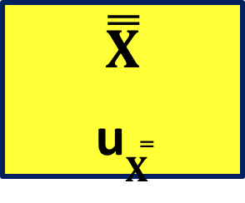


TV
u_{TV}
$\overset{̿}{X}$
u$\overset{̿}{X}$
Bias = $\overset{̿}{X}$ - TV
u_{bias} = $\sqrt{\text{u}\text{2}\text{RM} +\text{u}\text{2}\text{Mean} }$
U_{bias} = $m∗\text{u}\text{bias}$
t-value for P_{adj}

Slide 101

Determine multiplier “m” (to expand uncertainty)
Combined DF (Satterthwaite’s approximation)
2
nSam = 1 → 0.975
nSam = 2 → 0.9875
nSam = 3 → 0.9917
Adjust Probability for nSam
P_{adj} = 1 – [0.05/(2*nSam)]
Determine “m” from t distribution
m = t(P_{adj}, df_{c})

Slide 102

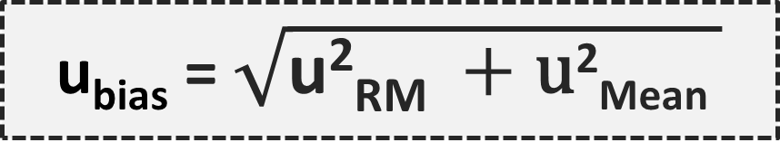
TV
u_{TV}
$\overset{̿}{X}$
u$\overset{̿}{X}$
Bias = $\overset{̿}{X}$ - TV
u_{bias} = $\sqrt{\text{u}\text{2}\text{RM} +\text{u}\text{2}\text{Mean} }$

Slide 103

TV
u_{TV}
$\overset{̿}{X}$
u$\overset{̿}{X}$
m
Bias = $\overset{̿}{X}$ - TV
u_{bias} = $\sqrt{\text{u}\text{2}\text{RM} +\text{u}\text{2}\text{Mean} }$
U_{bias} = m * u_{bias}

Slide 104

TV
u_{TV}
$\overset{̿}{X}$
u$\overset{̿}{X}$
m
Bias = $\overset{̿}{X}$ - TV
u_{bias} = $\sqrt{\text{u}\text{2}\text{RM} +\text{u}\text{2}\text{Mean} }$
U_{bias} = m * u_{bias}
VI = TV ± U_{bias}
Verification Interval

Slide 105





TV
u_{TV}
$\overset{̿}{X}$
u$\overset{̿}{X}$
Bias = $\overset{̿}{X}$ - TV
u_{bias} = $\sqrt{\text{u}\text{2}\text{RM} +\text{u}\text{2}\text{Mean} }$
U_{bias} = m * u_{bias}
m
VI = TV ± U_{bias}
Statistically Significant Bias
TV
- U_{Bias}
+ U_{Bias}
$$\overset{̿}{X}$$
$$\overset{̿}{X}$$

Slide 106

Interpretation
1. U_{Bias} < Allowable Bias?
NO: Cannot detect bias as large as B_{a}
Increase Run and/or Replicates
YES: Enough power to detect B_{a}
Evaluate “Bias” (2nd question)

Slide 107
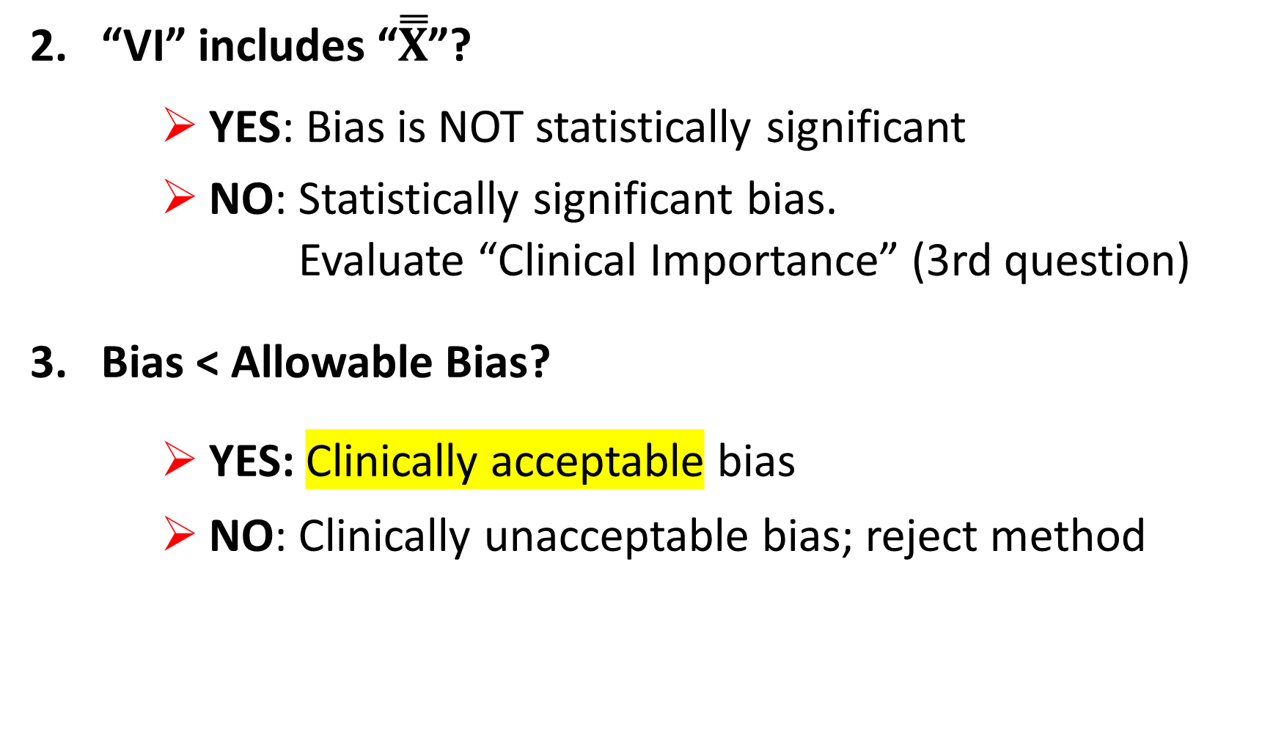
2. “VI” includes “$\overset{̿}{X}$”?
YES: Bias is NOT statistically significant
NO: Statistically significant bias.
Evaluate “Clinical Importance” (3rd question)
3. Bias < Allowable Bias?
YES: Clinically acceptable bias
NO: Clinically unacceptable bias; reject method

Slide 108
EXAMPLES

Slide 109
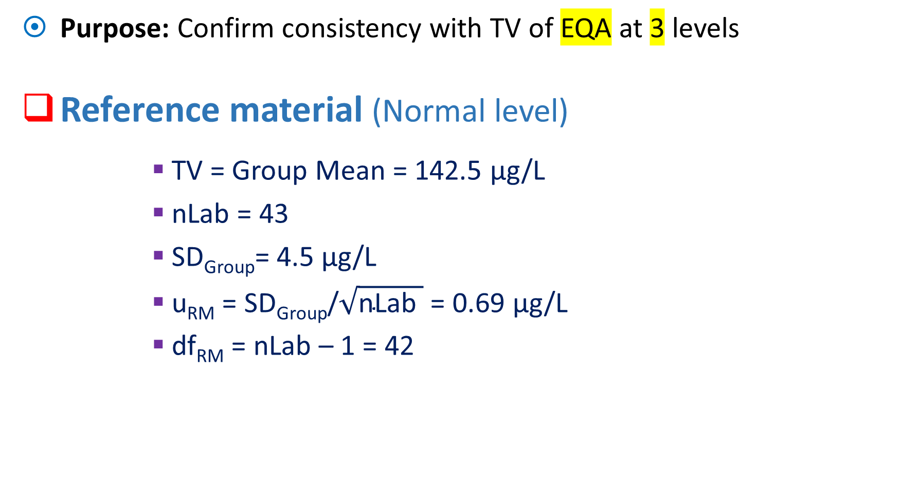
Estimating bias for a Ferritin assay
Purpose: Confirm consistency with TV of EQA at 3 levels
Reference material (Normal level)
TV = Group Mean = 142.5 μg/L
nLab = 43
SD_{Group}= 4.5 μg/L
u_{RM} = SD_{Group}/$\sqrt{\text{nLab} }$ = 0.69 μg/L
df_{RM} = nLab – 1 = 42

Slide 110
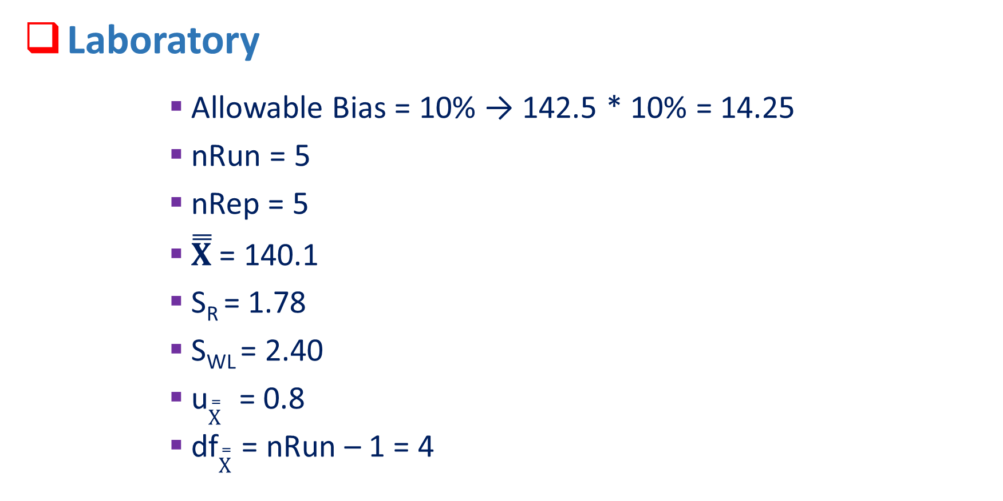
Laboratory
Allowable Bias = 10% → 142.5 * 10% = 14.25
nRun = 5
nRep = 5
$\overset{̿}{X}$ = 140.1
S_{R} = 1.78
S_{WL} = 2.40
u$\overset{̿}{X}$ = 0.8
df$\overset{̿}{X}$ = nRun – 1 = 4
u$\overset{̿}{X}$

Slide 111
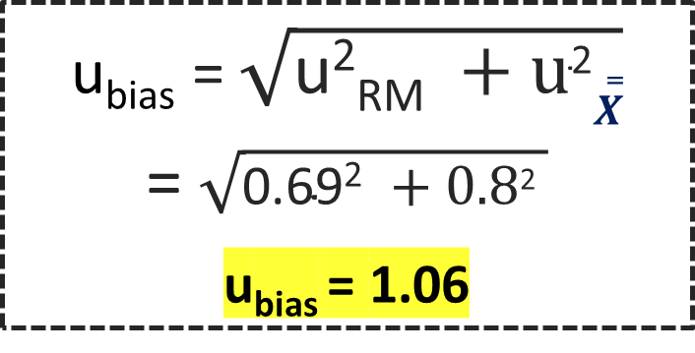
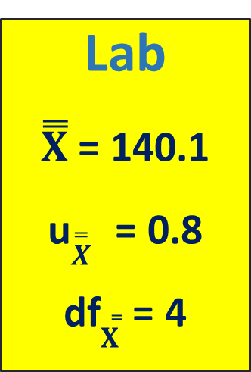
RM
TV = 142.5
u_{RM} = 0.69
df_{RM} = 42
u_{bias} = $\sqrt{\text{u}\text{2}\text{RM} +\text{u}\text{2}\overset{̿}{X}}$
= $\sqrt{\text{0.69}\text{2} +\text{0.8}\text{2} }$
u_{bias} = 1.06
P_{adj} = 1 – [0.05/(2*nSam)]
= 1 – [0.05/(2*3)]
P_{adj} = 0.9917
m = t(P_{adj}, dfc)
= t(0.9917, 9)
m = 2.94
2
Lab
$\overset{̿}{X}$ = 140.1
u$\overset{̿}{X}$ = 0.8
df$\overset{̿}{X}$ = 4
U_{bias} = m * u_{bias}
= 2.94 * 1.06
U_{bias} = 3.12
df_{C} = 9

Slide 112

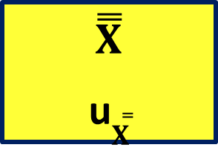
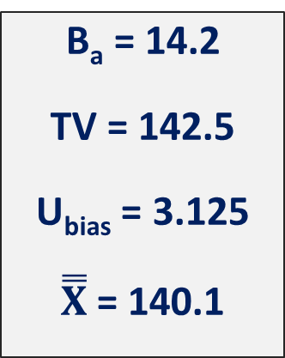
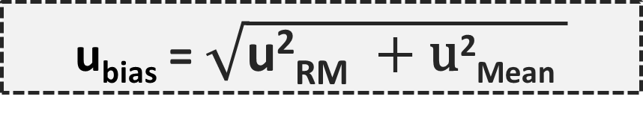
TV
u_{TV}
$\overset{̿}{X}$
u$\overset{̿}{X}$
Bias = $\overset{̿}{X}$ - TV
u_{bias} = $\sqrt{\text{u}\text{2}\text{RM} +\text{u}\text{2}\text{Mean} }$
U_{bias} = m * u_{bias}
m
B_{a} = 14.2
TV = 142.5
U_{bias} = 3.125
$\overset{̿}{X}$ = 140.1
U_{bias} < B_{a}?
3.125 < 14.25
VI = TV ± U_{bias}
= 142.5 ± 3.125
VI = [139.4, 145.5]
Enough data to detect bias = 14.25
139.4
142.5
145.5
140.1
Verification Interval
H₀, i.e. absence of bias, CANNOT be rejected
Bias in NOT statistically significant

Slide 113
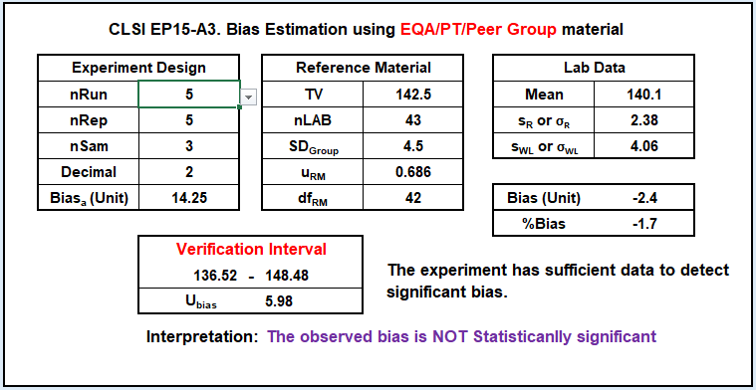

Slide 119
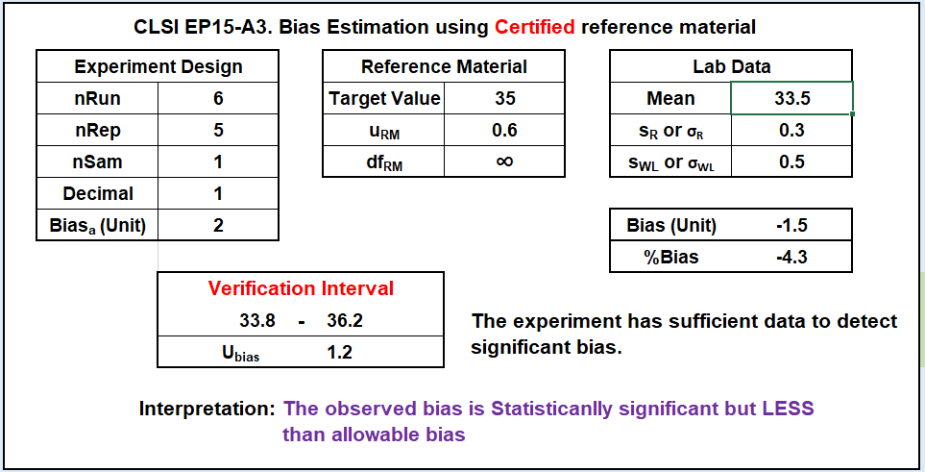

Slide 124
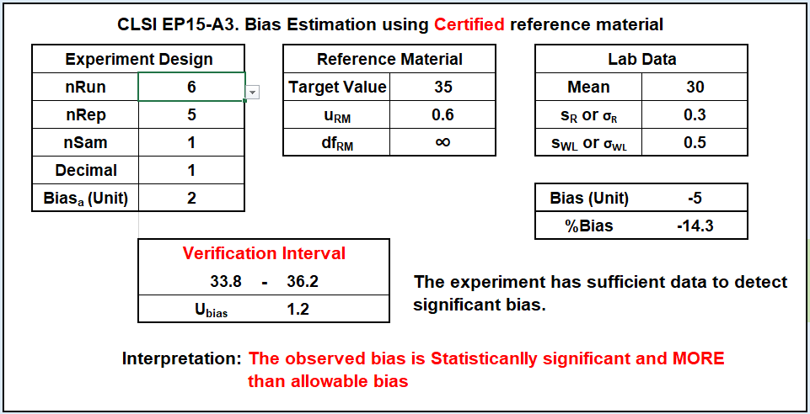

Slide 126
Successful completion of EP15
Laboratory demonstrates:
Consistency of precision in lab with manufacture’s claim
No significant or acceptable bias relative to the selected RM

Slide 127

THANKS!

